Slide 1
Community Policing In Schools
Every school in Swindon has a dedicated PCSO or PC.
To Support the school, students and parents.

Slide 2
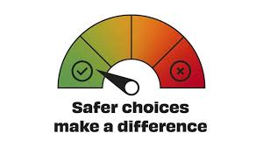



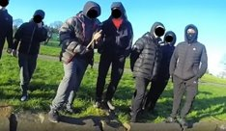
Lessons Delivered By Wiltshire Police To Primary and Secondary Schools
Making Safer Choices
Sexting and Healthy Relationships
Anti-Social Behaviour
Staying safe online
Exploitation and Vulnerability

Slide 3
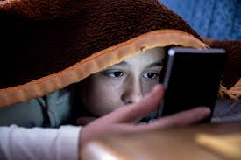
Phones And Social Media.
Have those conversations early and set the ground rules, make it clear that checks will be done by yourself(s)
Be that nosey Interested parent and know who they are talking to and what your children are doing on their phones.
Don’t let phones stay in the bedrooms overnight
Check security settings on the apps
Ask yourself if you really know what they are doing on their phone
If your child has changed their DOB to get a social media account, make sure they are still under 18
for example, if your child at 10 said they were 16 when they are 12 social media will think they are 18 so they will be open to content only suitable for adults.

Slide 4

Take A Second And Think...

Slide 5

Recognising The Signs Of Grooming
A Child Won't tell you, but their behaviour will
Change In Behaviour
Withdrawn to Confident ?
Rise of Causing Anti-Social Behaviour
Sudden Interest in Drill Music
Change of friendship Groups
Doubling up on clothing
Withdrawn from normal activities
Unexplained absences found in areas away from home.
Sudden hate for police/ authority
Possession of rubber bands/ lighters or debits cards, losing their phone and given a friends old/new phone.
Please don’t worry straight away if you see any of these signs. Talk to your young person, and if you are still concerned speak to a professional. This could be someone from school or the police.

Slide 6

Are You Really Listening?

Slide 7
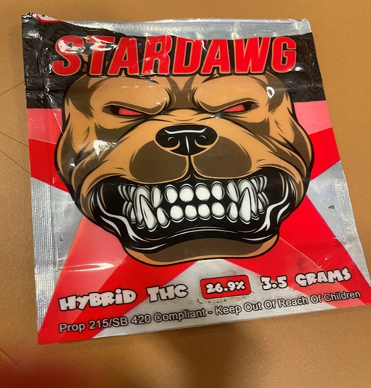
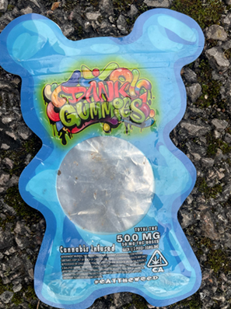

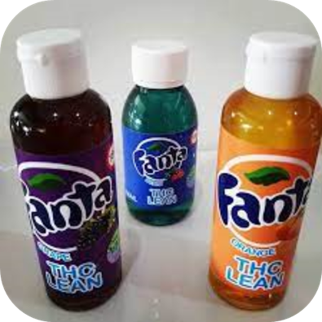
Drugs and Alcohol – Do you know if your child is using substances? Do you know what they are?
Many drugs are often packaged in packs that are very child appealing. Look at some of the images below, did you know that these are THC (Cannabis products)?
If you find out your child is using a substance please don’t panic. Talk to them about it and ask what they are using. Here is a link from Young Minds about having conversations with your children about drugs. You can also contact UTURN for advice and guidance.
Drugs & Alcohol | Mental Health | Guide For Parents | YoungMinds
Notes:
Cannabis products can be very high in THC – this means that tolerance can be developed quite quickly if they are used regularly. Equally if a child has not used these before they might experience a Cannabis overdose or what it referred to as a ‘whitey’ – they might feel faint, be hot and clammy and vomit – the effects will subside. There are synthetic substances being used in these products such as Spice, Xylaxine or most worrying Nitazenes. The illegal drug market in the UK is unregulated – this means that it is usually criminal gangs that have control of what is cut or adulterated into substances, it is all about profit. If a child starts to use substances young, especially under 15 they are more at risk of developing problematic use or dependency. At UTURN, we support children to make safe choices and to reduce/abstain from substances. We are also on Instagram – uturnswindon – give us a follow.

Slide 8






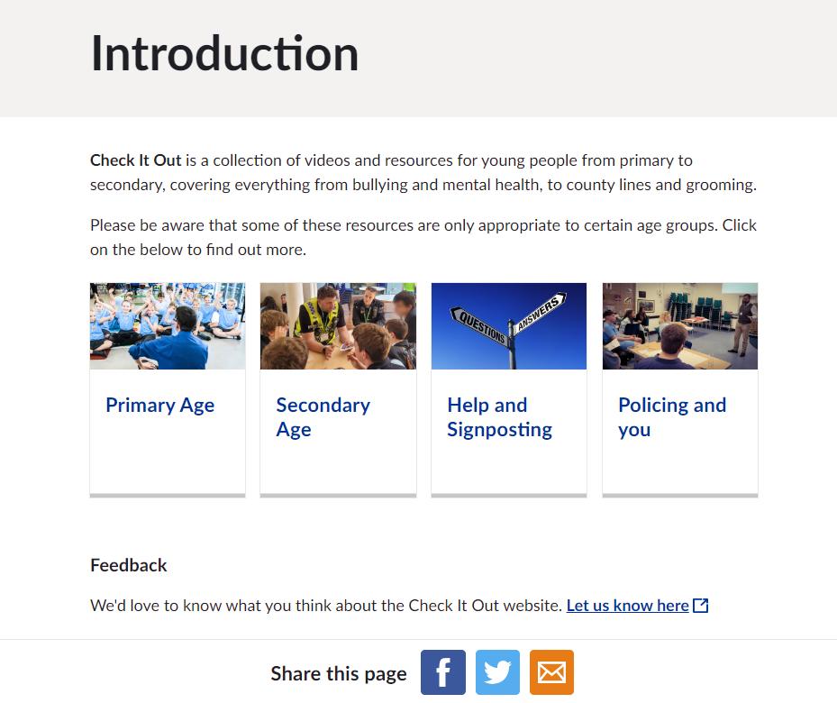



Further Support
Check It Out Website

